Slide 1
Office UI Fabric Meets Office 365 Unified API

Slide 2
Agenda
Office UI Fabric Fundamentals
Office UI Fabric with SharePoint-hosted add-ins
Office 365 Unified API Fundamentals
Mixing Office UI Fabric and the Unified API

Slide 3
Introduction Office UI Fabric
What is it?
a mobile-first, front-end CSS framework for developers
Uses HTML, CSS, theming, iconography, and patterns
Can be used to compliment or replace bootstrap
Why use it?
Standardize UI patterns in code across projects
Create UI experiences look and feel like the Office UI
Where to use it?
SharePoint add-ins
Office add-ins
Office 365 applications

Slide 4
Office Fabric UI Features
Typography
Color
Icons
Animations
Responsive grid
Localization support

Slide 5
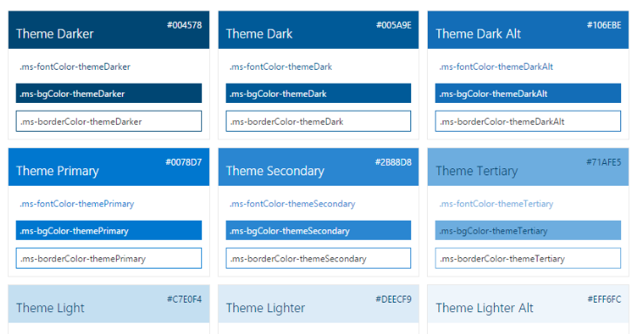
Theme Support

Slide 6
Components
Input Components
Layout components
Navigation components
Content components

Slide 7
Input Components
Buttons
Choice fields
Date Picker
Form field label
Search Box
Toggle
Text fields

Slide 8
Layout Components
List
Dialog box
Callout

Slide 9
Navigation Components
Navigation bar
Pivots

Slide 10
Content components
Persona
Persona card
List item
Table

